Slide 1
Unit 5
(Environmental Policies & Practices)
Lecture 20
(Climate change, global warming, ozone layer depletion, acid rain and impacts on human communities and agriculture)
1

Slide 2
Learning outcomes
After completing this lecture, you will be able to understand the following:
Student get knowledge about Global warming and green house effects.
Student aware about environment issue such as ozone layer depletion, Acid rain and their effect on Human and Environment.
2

Slide 3
Global Climate Change problem
Climate is the average weather of an area. The Intergovernmental Panel on Climate Change (IPCC) publishes evidence. Even small changes in climatic conditions may
disturb agriculture
leads to migration of animals including humans
increase the average global temperature
upsets hydrological cycle
temperature will fluctuate in different regions
Poles may experience 2 to 3 times more warming than the global average
disturbed global pattern of winds and ocean currents
some areas become wetter and the others drier
more evapo-transpiration
should limit warming to below 2°C relative to pre-industrial levels.
3
https://www.youtube.com/watch?v=eHMLszamZ9w

Slide 4

Greenhouse Effect and Global Warming
The term greenhouse effect is used to indicate a heat-trapping process caused by gases such as carbon dioxide, and water vapor which are transparent to incoming solar radiations but re-emit the infrared radiations from Earth's surface.
Global warming is a long-term rise in the average temperature of Earth as a whole as a result of greenhouse effect.
4

Slide 5
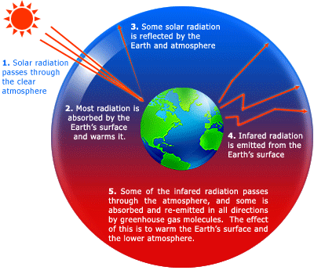
5

Slide 6
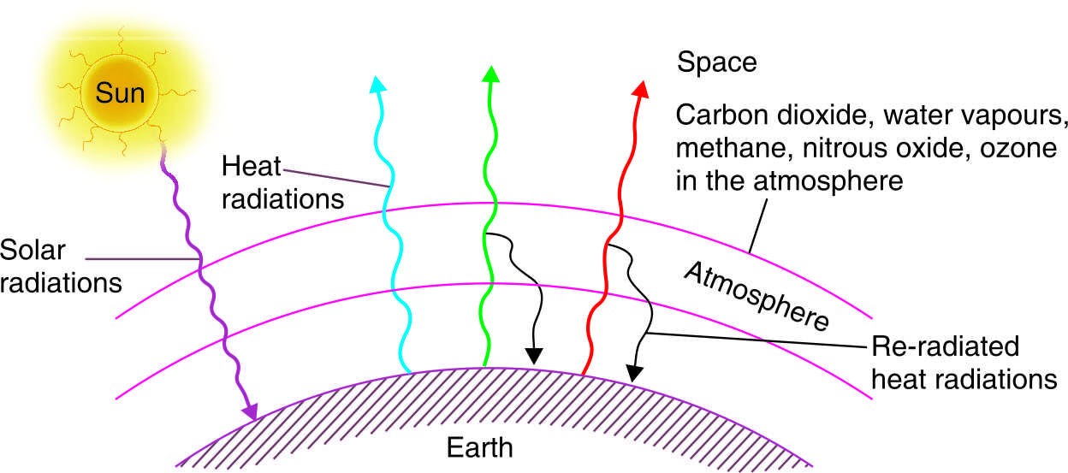
GLOBAL WARMING
Troposphere traps heat by a natural process -Greenhouse Effect
“Heat trapping” or “greenhouse” gases cause global warming
Carbon dioxide, • Ozone, • Methane, • Nitrous oxide,
Chlorofluorocarbons (CFCs) • Water vapours
The average global temperature is 15°C.
Warming or cooling by more than 2°C may prove to be disastrous
Some species could adapt or migrate
Fig. The greenhouse effect
6
Notes:
NEW AGE International Pvt Ltd

Slide 7
Impacts of Enhanced Global Warming
Global temperature increase
Effects on agriculture production
Weather change
Rise in sea level
Storms
Adverse effects on human health
Loss of ecosystems and biodiversity
7

Slide 8
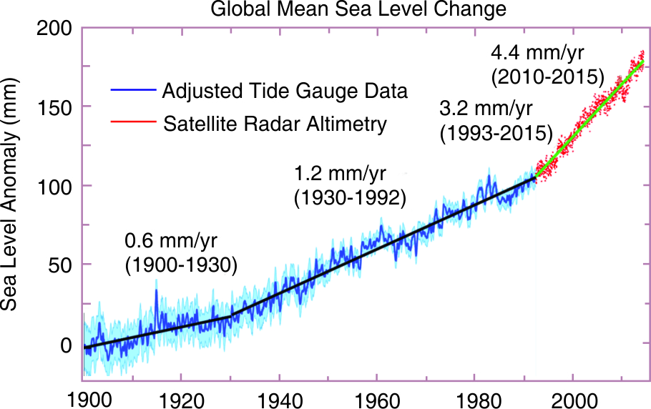
Fig. Recent sea level rise
8

Slide 9
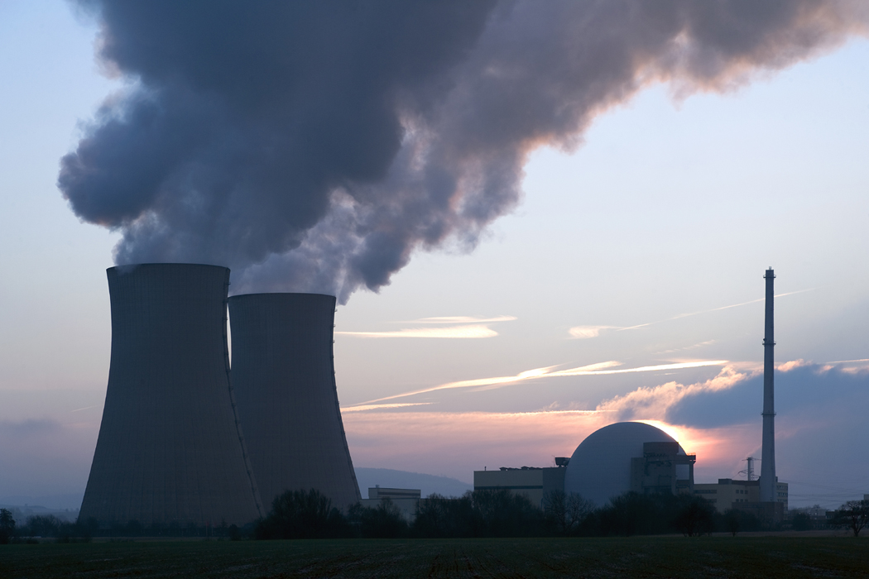
Greenhouses Gases
Carbon dioxide
Methane
Nitrous oxide
Chlorofluoro carbons
9

Slide 10

Activities Responsible for Emission of Greenhouse Gases
Fossil-fuel burning
Industrial processes
Deforestation
Biomass burning
Coal mining
10

Slide 11
Control measures
Reduction in the use of fossil fuels.
Shifting to the renewable energy sources that do not emit greenhouse gases.
Increasing the use of energy efficient and cleaner production technologies and practices.
Reducing deforestation, adopting better forest management practices, and undertaking afforestation to sequester carbon.
https://www.youtube.com/watch?v=G4H1N_yXBiA
11

Slide 12
Kyoto Protocol:
Stabilization of greenhouse gas concentrations in the atmosphere at a level that would prevent dangerous anthropogenic interference with the climatic system
12

Slide 13
Kyoto Protocol 1997 important points:
Kyoto Protocol was adopted on December 11, 1997 as a supplement to the United Nations Framework Convention on Climate Change (UNFCCC).
Richer countries are subject to legal binding to cut greenhouse gas emissions by a minimum 5% in the 1990 before 2012. Later, US realizing its legal obligations agreed to sign the protocol in reducing the emissions like other countries including China and India. Developing countries also agreed to reduce their emissions provided these get financial and technical support.
Important features:
Clean Development Mechanism (CDM)
Emission trading
Joint implementation
13

Slide 14
Acid Rain
Acid rain refers to a condition in which natural precipitation becomes acidic after reacting chemically with pollutants in the air.
Causes of Acid Rain
Burning of the fuel as well as the use of nuclear weapons leading to the evolution of large amounts of sulphur dioxide (SO₂) and nitrogen dioxide (NO₂), which get converted to sulphurous/sulphuric acid and nitric acid, respectively.
14

Slide 15
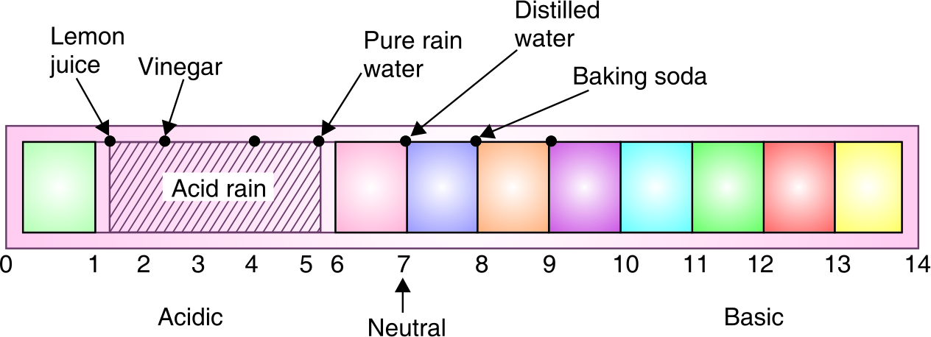
ACID RAIN : Oxides of sulfur and nitrogen
Acidic deposition: total of wet acidic deposition (acid rain) and dry deposition. Rainwater is turned acidic when its pH falls below 5.6
Fig. The pH scale of common substances
15

Slide 16
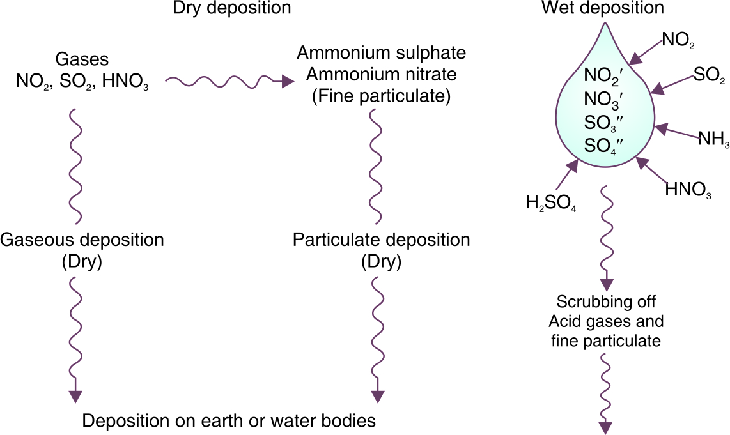
The strong acids release H+
Sulfuric acid forms a major fraction of acid rain, followed by nitric acid
Ammonium (NH₄⁺) ions help to neutralize the rain drops
Fig. Acid deposition (dry deposition and wet deposition)
16

Slide 17
Adverse Effects of Acid Rain
Reduction in population of aquatic biota: Due to presence of more acid content, chance of loss of biodiversity increases.
Damage to terrestrial ecosystems: Ex- Change in Soil pH leads to effect on fertility followed by desertification process
Corrosion(Corrosion refers to any process involving the deterioration or degradation of metal components) of buildings :Ex-rusting of Iron
Effect on human beings : Health issues such as skin problem, Economic growth
https://www.youtube.com/watch?v=1PDjVDIrFec
17

Slide 18
Ozone Layer and Its Depletion
The decrease in the concentration of ozone (O₃) in stratosphere is known as ozone layer depletion.
Chief Cause
Widespread use of chlorofluorocarbons (CFCs).
Transportation vehicles (Air craft, Aero planes)
18

Slide 19
CFCs
CFCs are powerful O₃ destroyers. They are used in the following ways:
As coolants in the compressors of refrigerators and air conditioners.
To clean electronic circuit boards used in computers, telephones, etc.
In the manufacture of foams for mattresses and cushions, disposable styrofoam cups, packaging material, cold storage, etc.
19

Slide 20
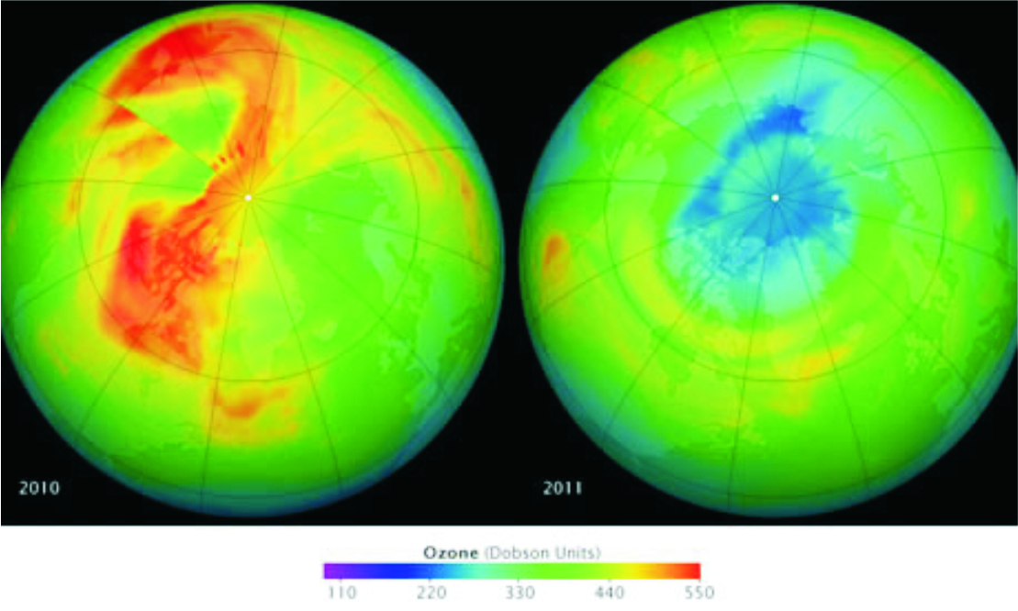
Ozone Hole
The thinning of ozone layer or reduction in concentration of ozone especially over the area of Antarctic continent is known as ozone hole, which covers approximately seven million square kilometer.
Fig: Levels of Ozone above the Arctic on 19 March 2010 (left)
and 26 March, 2011 (right)
20

Slide 21


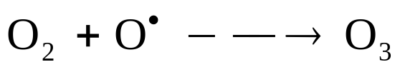
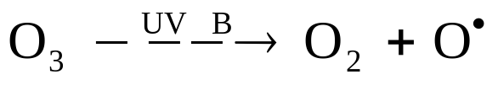


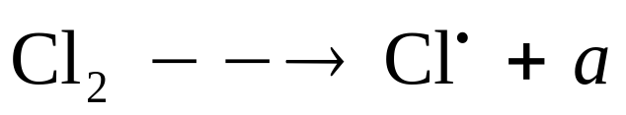
Mechanism of Ozone Layer Depletion
a)
b)
c)
d)
e)
22

Slide 22
Environmental Effects of O₃ Layer Depletion
Damage to land plants
Decrease in population of aquatic community
Increase in the rate of skin diseases and cancers in human beings
Disturbance in climate patterns
Corrosion of materials
23

Slide 23
Control Measures
Evolving substitutes for CFCs
Development of hydrochloroflourocarbons and hydrofluorocarbons
Montreal Protocol 1987
https://www.youtube.com/watch?v=aU6pxSNDPhs
24

Slide 24
Montreal Protocol:
Designed to protect the ozone layer by phasing out the production of a number of substances believed to be responsible for ozone depletion
Important Point:
International agreement on the Ozone Depletion Substances (ODS)
Montreal Protocol was signed in 1987, production and consumption of ozone depleting substances are to be phased out by 2000
25

Slide 25
The developing countries had to freeze their consumption (of chlorofluorocarbon) at the then present level
The developed countries will continue the use as their requirement is high.
The developed countries refused to provide knowhow of the technology.
The request of developing countries to provide funds to shift to new technologies was also refused.
During the review of Montreal Protocol : Funds were provided for developing countries by the developed nation to switch over to chlorofluorocarbon (CFCs) substitutes.
After this London meet India signed the protocol.
26

Slide 26
Important Video/Web Link
https://www.ugc.ac.in/oldpdf/modelcurriculum/env.pdf
https://www.nrdc.org/stories/global-warming-101#warming
https://www.nationalgeographic.com/environment/global-warming/acid-rain/
27

Slide 27
Acknowledgment
Some images, animation, and material have been taken from the following sources:
Text Books: PERSPECTIVE IN ENVIRONMENTAL STUDIES by ANUBHA KAUSHIK, C P KAUSHIK, NEW AGE INTERNATIONAL PUBLISHERS
References Book: TEXT BOOK OF ENVIRONMENTAL STUDIES by D. DAVE AND S. S. KATEWA, CENGAGE LEARNING
3 All slides can be used for reading purpose only
28

